Slide 1
RTC+B Market Trials Systems Readiness for Market Submissions
Sruthi Hariharan
February 27, 2025

Slide 2
RTC+B Market Trials – Submissions Testing
This presentation covers the plan for ERCOT RTC+B Market Trial system configurations and digital certificates to support the stages of market trials and go-live to achieve the following:
Isolate initial testing path for QSE/Vendor Sandbox testing from current production
Minimize risk of RTC+B market submissions impacting current production
Start
03/2025
Start
05/2025
Start
07/2025
Start
09/2025
Go-Live
12/5/25*
Feb 2025
Feb 2025
Mar 2025
Apr 2025
May 2025
June 2025
July 2025
Aug 2025
Sep 2025
Oct 2025
Nov 2025
Dec 2025
Optional: RTC QSE/Vendor Developer
Submission Testing
RTC QSE
Submission Testing
Open-loop
RTC SCED
RTC Vendor
Submission Testing
RTC QSE
Submission Testing
Open-loop
RTC SCED
Ongoing Open-Loop
& Periodic Closed-loop SCED/LFC
Ongoing Open-Loop
& Periodic Closed-loop SCED/LFC
* Go-Live date reflects 12/5/2025 as first Operating Day
where 12/4/2025 is planned software migration.

Slide 3
RTC+B Market Submissions - Systems configurations
Start
03/2025
Start
05/2025
Start
07/2025
Start
09/2025
Go-Live
12/5/25*
Feb 2025
Mar 2025
Apr 2025
May 2025
June 2025
July 2025
Aug 2025
Sep 2025
Oct 2025
Nov 2025
Dec 2025
Optional: RTC QSE/Vendor Developer
Submission Testing
RTC QSE
Submission Testing
Open-loop
RTC SCED
Ongoing Open-Loop
& Periodic Closed-loop SCED/LFC
Certificate: Current MOTE
Env: ERCOT RTC Market Trial
URL: RTC MIS MOTE URL
Certificate: Current Production
Env: ERCOT RTC Market Trial
URL: RTC MIS Market Trial
Cert: Production
Env: Prod
URL: MIS Prod
QSE/Vendor developer can use MOTE certificates & RTC MIS MOTE API URL to test the submissions until end of submission testing phase (end of June) as needed. At the start of the Open Loop testing, RTC MOTE MIS URLs will be disabled.
URL links: RTC MOTE and Market Trial URL links to be used for MMSUI, OSUI and API submissions. Actual links are provided in next slide.
For notifications/responses to MPs from RTC Market Trials environment, MP will need to provide the listener URL to ERCOT

Slide 4
RTC+B Market Submissions - Systems configurations
Currently (pre-RTC),
 | Digital Certificate | MMSUI/OSUI | API
Current MOTE | Current MOTE | MOTE MIS URL: testmis.ercot.com/mmsui testmis.ercot.com/osui | MOTE MIS API URL: testmisapi.ercot.com /2007-08/Nodal/eEDS/EWS/ testmisapi.wan.ercot.com:9443/2007-08/Nodal/eEDS/EWS/
Current Prod | Current Production | PROD MIS URL: mis.ercot.com/mmsui mis.ercot.com/osui | PROD MIS API URL: misapi.ercot.com/2007-08/Nodal/eEDS/EWS/ api.wan.ercot.com:8443/2007-08/Nodal/eEDS/EWS/

Slide 5
RTC+B Market Submissions - Systems configurations (Updated with URLs)
RTC+B Market Trials and Go-live
RTC Phase | Digital Certificate | MMSUI / OSUI URL | API / WAN URL
Vendor/QSE Submissions Testing | Current MOTE | RTC MOTE MIS URLs https://testmarkettrials.ercot.com/mmsui/mmsui/displayTradesLanding.action https://testmarkettrials.ercot.com/osrui/osrui/Summary.action | RTC MOTE API/WAN URL https://testmarkettrialsapi.ercot.com/NodalAPI/EWS/ https://testmarkettrialsapi.wan.ercot.com/NodalAPI/EWS/
Open Loop and Closed Loop Testing | Current Production | RTC Market Trial URL https://markettrials.ercot.com/mmsui/mmsui/displayTradesLanding.action https://markettrials.ercot.com/osrui/osrui/Summary.action | RTC Market Trial API/WAN URL https://markettrialsapi.ercot.com/NodalAPI/EWS/ https://markettrialsapi.wan.ercot.com/NodalAPI/EWS/
From RTC Go-live onwards | Current Production | Current Prod MIS URL mis.ercot.com/mmsui mis.ercot.com/osui | New Production API/WAN URL

Slide 6
RTC+B Market Submissions - Systems configurations Public Key Update for WAN/API submissions
For API/WAN submissions into Market Trials environments, need to download public keys and place into the keystore location in system being used for RTC+B submissions.
No change to digital user certificates – continue to use existing MOTE and Production Certificates
Market Trail API Public key location: https://www.ercot.com/services/mdt/webservices

Slide 7
RTC+B Market Trials Systems Readiness Summary
RTC+B Market Trials Systems are built and setup for market submissions testing from Market Manager UI and through API.
Latest RTC+B market submissions code was deployed, internal testing is in progress
Market Trials Systems will be released for QSEs and their vendors developer level testing from 03/07/2025 and will be open until 04/30/2025.
Valid current MOTE certificates are required to connect to RTC+B Market Trials Systems for this phase of testing.
This first release into the Market Trials environment is being considered a “Sandbox release” as it is an early release with limited capability.
ERCOT is performing limited testing considering market facing environment setup. ERCOT will work with QSEs and with their vendors to resolve any issues.
Report issues to ERCOT at rtcb@ercot.com
Market Notice was sent on 2/26/2025 with details on QSE/Vendor sandbox testing.
https://www.ercot.com/services/comm/mkt_notices/M-B022625-01

Slide 8
Frequently asked questions related to Market Trials submission testing
What are the different submissions that QSE needs to submit for each phase of Market Trials?
What is the duration for which QSE needs to submit for each phase of Market Trials?
What actions/applications will ERCOT be running during each phase?
What are performance evaluation criteria for the QSEs for each phase of Market Trial testing?

Slide 9
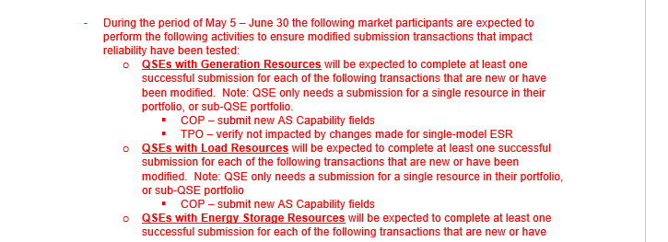
Market Submissions Handbooks Review
For each phase of Market Trial testing, a handbook will be posted to the RTBTF web page - https://www.ercot.com/committees/tac/rtcbtf
Handbook to cover the expectations for each phase of testing, including
the key activities for that testing phase,
required submissions and expectations of submissions data entry with regard to current Production submissions. For example, during closed loop testing we would expect RTC submissions to closely align with current Production submissions to ensure smooth transition into and out of closed loop testing,
QSE performance evaluation criteria,
and high-level timelines for each phase.
For example: screenshot from Handbook 1 – RTC QSE Submission Testing (https://www.ercot.com/files/docs/2025/01/13/5_RTCB_Market_Trials_Handbook_1_MarketSubmissions_12102024_v2.docx)

Slide 10
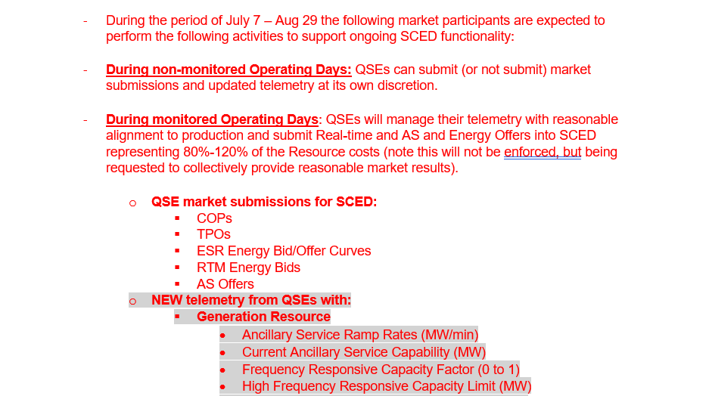
Market Submissions Handbooks Review
Example 2: RTC Market trials Handbook 3 - Open loop testing (DRAFT)
https://www.ercot.com/files/docs/2025/02/19/6a_RTCB_Market_Trials_Handbook_3_OpenLoop_RTC_SCED_02192025_POST.docx

Slide 11
RTC+B Market Trials Systems Readiness for Market Submissions
Questions?
Provide feedback to ERCOT on any concerns/questions at rtcb@ercot.com

