Slide 1
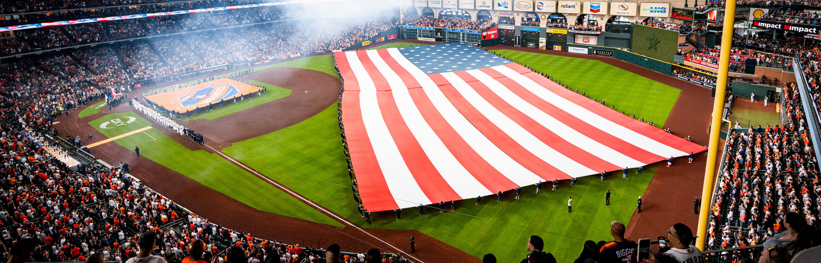
TEXAS SET UPDATE
Retail Market Subcommittee
April 1, 2025

Slide 2
UPDATE
Flight 0225 Update
Reviewed/Updated Texas SET script book
Change Control Call
TDSPs drafting language for TMTP section for SET to review

Slide 3
Voting Items
TXSETCC853: Add BGN07 of IA and CR to the 814_06
TXSETCC852: Clarifications of Friday Disconnect for Non-Payments

Slide 4
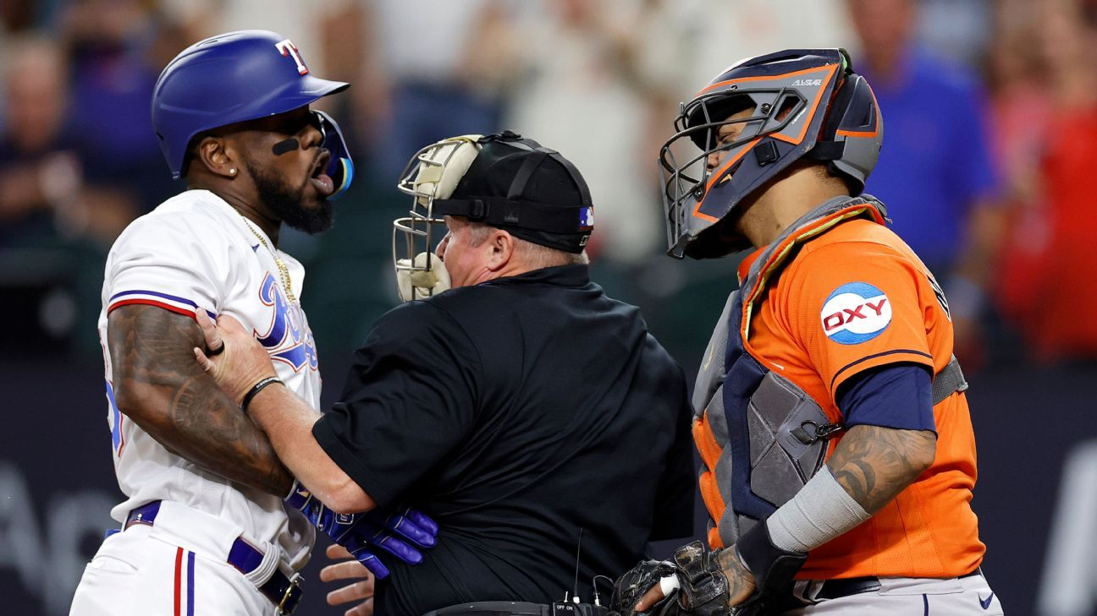
NEXT MEETING
April 22nd
WEBEX Only

