Slide 1
Real-Time Co-optimization + Batteries: General Education
David Maggio
Principal, Market Design & Analytics
Demand Side Working Group (DSWG)
ERCOT Public
April 17, 2025

Slide 2
Agenda
Why is the Real-Time Co-optimization plus Batteries (RTC+B) project so important?
What does it mean to “co-optimize?”
What components of the market are changing with Real-Time Co-optimization (RTC)?
How is this impacting communications between ERCOT and Market Participants?
What is the “plus Batteries” part of the project?
What is the timeline for testing and implementation of the project?

Slide 3
Why is the RTC+B project so important?

Slide 4
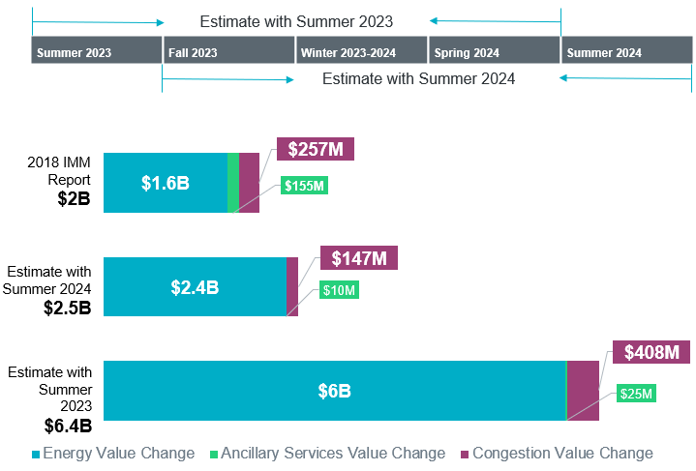
Estimated annual savings of RTC+B compared to 2018 IMM report
The Independent Market Monitor (IMM) and ERCOT have both done back-cast studies to assess the operational and market efficiencies with RTC+B. These studies have consistently shown potential cost savings to the market in excess of $2 billion per year.
Key Takeaway: IMM 2018 study of Operating Year 2017 estimated $2 billion in cost savings.
ERCOT 2024 study of more recent years shows $2.5 – $6.4 billion estimated annual cost savings, representing 17-21%.

Slide 5
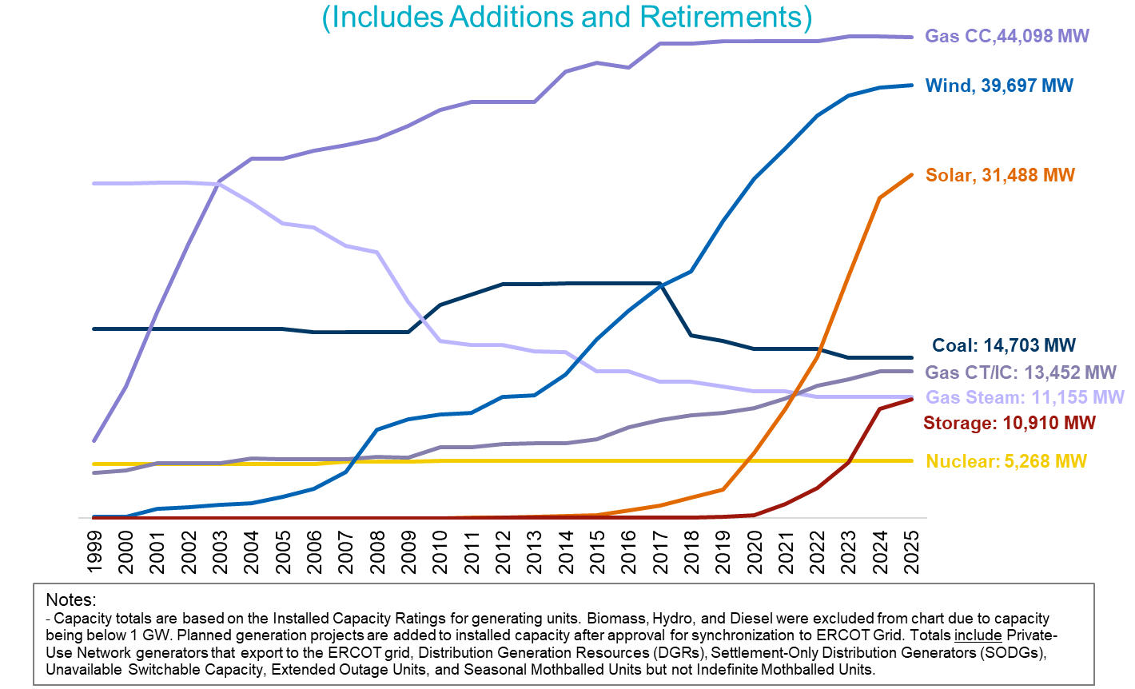
ERCOT installed net generation capacity (as of April 1, 2025)
End of 2028 (MW)
[Based on GIS Info]
WIND: ~ 46,000
PV: ~ 72,000
ESR: ~ 38,000

Slide 6
What does it mean to “co-optimize?”

Slide 7
Under RTC, energy and Ancillary Services are “co-optimized,” but what does it mean to co-optimize?
Currently
Gen 1
Gen 2
Ancillary Service Capacity
$/MWh
$/MWh
300
50
20
150
10
80
MW
MW
200
300
400
50
150
250
$20/MWh
$150/MWh
$10/MWh
$10/MWh
The placement of Ancillary Services on Resources across the ERCOT System is assumed.

Slide 8
Under RTC, energy and Ancillary Services are “co-optimized,” but what does it mean to co-optimize?
Under RTC
Gen 1
Gen 2
Ancillary Service Capacity
$/MWh
$/MWh
300
50
20
150
10
80
MW
MW
200
300
400
50
150
250
Ancillary Service offer $10/MWh
Ancillary Service offer $20/MWh
$60/MWh
$10/MWh
By awarding the Ancillary Services to another Resource, overall costs are reduced.

Slide 9
What components of the market are changing with RTC?

Slide 10
Today’s market is designed to reflect scarcity through a process that is outside of the optimization
Currently
Energy Offers
Security- Constrained Economic Dispatch
(SCED)
Base
Points
Telemetry
Locational Marginal Prices (LMPs)
Constraints
Combined to form Settlement Point Prices
Operating Reserve Demand Curve (ORDC)
Reserve Pricing
Price Adders

Slide 11
The ORDC sets the value of ERCOT System reserves
ORDC Price Adders determined based on level of reserves

Slide 12
RTC is also designed to reflect scarcity, but now it occurs within the optimization
Under RTC
Energy & Ancillary Service Offers
SCED
Base
Points
Form Settlement Point Prices
Telemetry
LMPs
Constraints
Ancillary Service Awards
Ancillary Service Demand Curves (ASDCs)
Ancillary Service Prices

Slide 13
Unlike today’s market, the cost of Ancillary Services is factored directly into LMPs
Today, the need for an additional MWh of energy results in the price of energy (i.e., the LMP) going from $30/MWh to $50/MWh
The next MWh would come from Gen 2
Ancillary Service Offer
= $10/MWh
Ancillary
Service
Capacity
Ancillary Service Offer
= $20/MWh
Energy Offer
= $30/MWh
Energy Offer
= $50/MWh
Gen 1
Gen 2

Slide 14
Unlike today’s market, the cost of Ancillary Services is factored directly into LMPs
Example: With RTC, Ancillary Services can be reallocated to access cheaper energy from Gen 1. However, this has the effect of increasing Ancillary Services cost.
This means the LMP goes to $40/MWh ($30/MWh for the energy from Gen 1 plus the $10/MWh of additional Ancillary Service cost)
  Ancillary Service Price: $10/MWh → $20/MWh
Ancillary Service Offer
= $10/MWh
Ancillary
Service
Capacity
Ancillary
Service
Capacity
Ancillary Service Offer
= $20/MWh
Energy Offer
= $30/MWh
Energy Offer
= $50/MWh
Gen 1
Gen 2

Slide 15
Instead of using the ORDC, under RTC, scarcity pricing and the value of reserves is set by individual ASDCs
Sufficient remaining capacity and offers
Insufficient remaining capacity or offers
Value of the Ancillary Services

Slide 16
ASDCs will be based on the shape and pricing outcomes of the current ORDC mechanism

Slide 17
Having individual ASDCs allows RTC to better distinguish and prioritize between various Ancillary Service products
The prioritization is set by the ASDC price
What should the optimization do when it can’t procure all the desired Ancillary Services and meet electric demand? The ASDCs help to make this decision where much of the Regulation Up (Reg-Up) and RRS is given priority over ECRS and Non-Spin.

Slide 18
While the primary focus is the Real-Time Market, changes to other parts of the wholesale market are also part of RTC
DAM
RUC
RUC
SASM
Hour-Ahead
Operating Hour
Reporting
Performance Monitoring
Settlement
Day-Ahead Operations
Adjustment Period
Operating Period
Post Real-Time

Slide 19
Reliability Unit Commitment (RUC), like Real-Time, currently takes Ancillary Service assignment to individual Resources as a known input
Ancillary
Service
Capacity
Ancillary Service capacity is assigned to Resources by Market Participants to fulfill Ancillary Service Supply Responsibilities
Available
for
Energy
Dispatch
RUC attempts to meet forecasted demand and solve transmission congestion with remaining capacity, not reserved for Ancillary Services
System Capacity
Currently

Slide 20
To better reflect and plan for Real-Time grid conditions with RTC, RUC will also be modified to co-optimize energy and Ancillary Services
Available
for
Energy
Dispatch
or
Ancillary
Services
RUC attempts to meet forecasted demand, solve transmission congestion, and meet system Ancillary Service needs using the full capability of Resources planned to be available
System Capacity
Under RTC

Slide 21
The current DAM fundamentally stays the same with the implementation of RTC
Energy Offers & Bids
DAM
Energy Awards
Point-to-Point (PTP) Obligation Bids
PTP Obligation Awards
Ancillary Service Offers*
Ancillary Service Awards
ASDCs
* With RTC, “virtual” Ancillary Service Offers will be allowed.

Slide 22
The current SASM process will be eliminated with the implementation of RTC
SASM allows ERCOT to fill Ancillary Service gaps that appear after completion of the DAM
Failure to provide
Infeasible Ancillary Service capacity
More Ancillary Service capacity needed
Insufficient Ancillary Service offers in the DAM
SASM
Ancillary Service
Awards
Under RTC, a co-optimized RUC and the Real-Time Market fulfill this role.

Slide 23
Changes in RTC will also impact performance monitoring
Generation Resource Energy Deployment Performance (GREDP) and Controllable Load Resource Energy Deployment Performance (CLREDP) calculations will be updated to account for changes made to deployments instructions from ERCOT, specifically the transition to “Updated Desired Set Point.”
  Equivalent changes also being made to Base Point Deviation settlement processes.
2 major compliance requirements and associated reporting are eliminated:
  With RTC, the concept of a physical Ancillary Service obligation based on DAM awards, self-arrangement, and trades is no longer relevant. Instead, these forward transactions only create a financial obligation.
  With changes in Real-Time to Ancillary Service “deployment,” the updating on Ancillary Service Schedules following instruction for the purpose of adjusting High Ancillary Service Limits (HASLs) is no longer relevant.

Slide 24
How is this impacting communications between ERCOT and Market Participants?

Slide 25
With RTC, there will be several changes in the data flow between ERCOT and Qualified Scheduling Entities (QSEs)
Currently
Under RTC
Ancillary Service Resource Responsibilities
Ancillary Service Resource Capabilities & Real-Time Ancillary Service Awards
Ancillary Service-Specific Resource Statuses
More General Resource Statuses
Regulation Service Participation Factors/QSE-Level Deployments
Resource-Specific Regulation Deployments
Updated Desired Base Points
Updated Desired Set Points
ORDC Price Adders
Real-Time Ancillary Service Prices
Some of these affect both Real-Time (telemetry) and Adjustment Period (COP) communications between ERCOT and QSEs.

Slide 26
There will also be changes to many reports, extracts, and dashboards
Examples:
New
Ancillary Service Disclosure reports for Real-Time
Real-Time Ancillary Service prices
ASDCs
Going Away
SASM reports
ORDC reports
Ancillary Service Supply Responsibility reports and notifications
Modified
Other Disclosure reports
Performance Monitoring reports
Market submission validation rules
Short-term system adequacy reports
Ancillary Service capacity monitor

Slide 27
What is the “plus Batteries” part of the project?

Slide 28
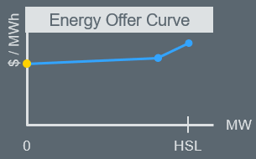
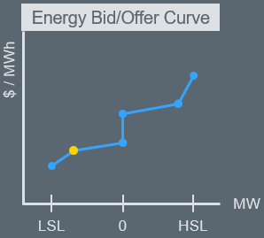
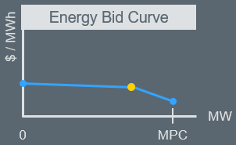
Energy Storage Resources (ESRs) will now be fully seen as a single device within ERCOT’s systems
Currently
Future
High Sustained
Limit (HSL)
Ancillary Services
HSL
Ancillary Services
Discharge
Generation Resource
Ancillary Services
Discharge
Ancillary Services
0
0
Controllable Load Resource
Charge
No extra coordination needed
Reduced administration for ERCOT and QSEs
Real-time market and RUC systems will change to capture capabilities and characteristics of ESRs.
Charge
Ancillary Services
Ancillary Services
Max Power Consumption (MPC)
Low Sustained Limit (LSL)
2 Current Operating Plans
2 sets of telemetry
Submission dependencies
2 Resources

Slide 29
What is the timeline for testing and implementation of the project?

Slide 30
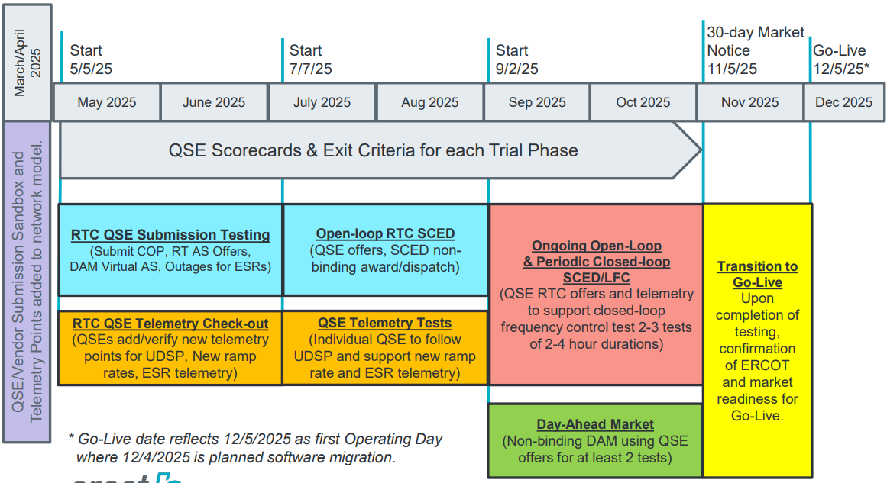
There are several testing activities planned for ERCOT and QSEs prior to implementation of the project

Slide 31
Thank You!

