Slide 1
Discussion of High LMPs observed on February 19, 2025
ERCOT Staff
Congestion Management Working Group
April 14, 2025
ERCOT Public

Slide 2
Stakeholder Questions
Understand the situation on the morning of 2/19 (record setting LMPs)
Understand why multiple compounding constraints & contingencies were activated
Understand the operating procedure related to activating in series constraints where post-contingency loading > 98%
The procedure states only the most limiting constraint should be activated. We are thinking this makes sense, as solving the “worst” issue would likely resolve the rest.
What is the definition of “in series”?
Were any of the elements in series on 2/19? Would one-line diagrams be helpful here?
If the procedure and 2/19 actions are deemed acceptable by ERCOT, is there another way to limit the compounding nature of constraints with multiple contingencies?
Ex. introduce shadow price cap split between multiple contingencies on a single line. We are ultimately seeking to limit the price impact of a single line.

Slide 3
LMP Calculation
ERCOT Market Analysis team investigated the LMPs in question on 2/19
There is an electrical bus associated with the Settlement Point RHESS2_ES1 with a very large helping shift factor on multiple constraints that were violated (at max shadow price), which based on the LMP calculation (System Lambda – sum(SF*Shadow Price)) results in the very large LMP observed. (see next slide)

Slide 4
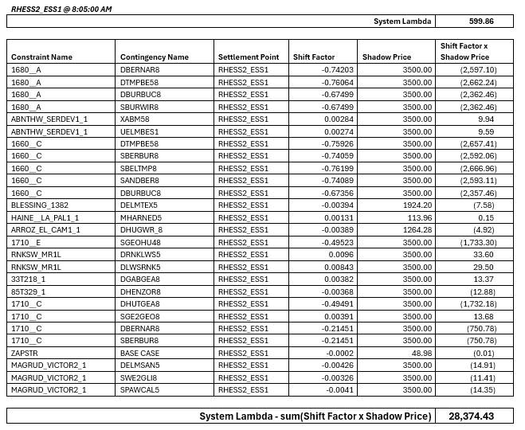
LMP Calculation

Slide 5
February 19, 2025
System Conditions
Winter Storm Kingston: 2/18 -2/21
All-time winter demand record on 2/20
Multiple planned outages in the Round Rock, Georgetown & Temple area
Request to restore outages were made leading up to winter storm
Lengthy restoration times, up to 240 hours
Real-Time Constraints
@ 8:07 a total of 77 constraints greater than 100% in RTCA
40 constraints in RTCA in the Georgetown, Round Rock & Hutto area
Overloaded element: 1660_A,C & 1680_A,B,E,F
15 constraints with overloads greater than 125% cascading criteria
9 of the 40 were activated to SCED
A
B
C
ST1
ST2
ST3
ST4
Gen

Slide 6
Q&A Discussion

