Slide 1
Demand Side Working Group (DSWG)
Changes for Load Resources in the Upcoming RIOO Release
April 17, 2025
Donald House

Slide 2
Changes for Load Resources in the upcoming RIOO release
There are 2 changes impacting Load Resources (LRs) in the next RIOO update release on April 24, 2025
A new requirement to select the type of Load associated with each LR
Ability to view and update the Critical Load Attestation for each LR in RIOO – Resource Services (RIOO – RS)

Slide 3
Type of Load associated with LRs
To improve ERCOT’s visibility into the type of Load associated with each LR, ERCOT will start requiring this information during the initial registration process in RIOO
The Resource Entity (RE) must select the type of Load from a dropdown list
There will be a freeform data entry to provide additional details for some of the selections, but the list should cover most potential Load types
This was discussed with DSWG on 1/27/2025, and a draft list was posted for review and comments on the 1/27/2025 DSWG meeting webpage
The finalized list has also been posted to that same meeting page
Future changes to the list can quickly be added to RIOO, as needed
This field will be available for REs in RIOO – RS to view and update
ERCOT will work with REs to submit RIOO Change Requests (RSCRs) to add the type of Load for all existing LRs

Slide 4
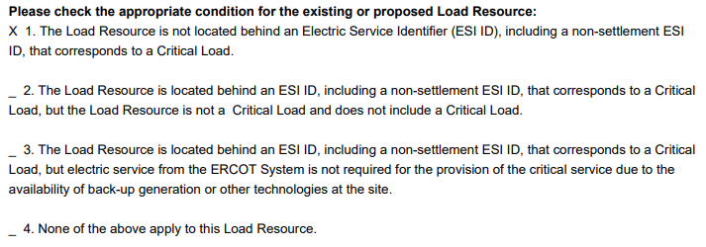
Critical Load Attestations added to RIOO – RS
REs are required to complete the Critical Load Attestation for each new LR registered in RIOO – IS
Now, the RE will be able to view the current selection for each of their LRs in RIOO – RS
The RE will also be able to change their selection, if needed, by submitting an RSCR
Note that condition 4 means that the Load is Critical; an LR can’t be registered at a Critical Load

Slide 5
Critical Load Attestations added to RIOO – RS
ERCOT will pre-populate the field with the attestation condition currently on file for each LR
ERCOT will ask REs to verify the data and to provide any missing selections or update the condition, as needed

Slide 6
Comments or questions?
Comments or questions about LR registration data can be sent to the Demand Integration team at ERCOTLRandSODG@ercot.com

