Slide 1
CRR Updates
Samantha Findley
CRR Market Operations
CMWG
April 14, 2025

Slide 2
Agenda
LTAS transactions and solution times
Update to CRR auction limits table

Slide 3
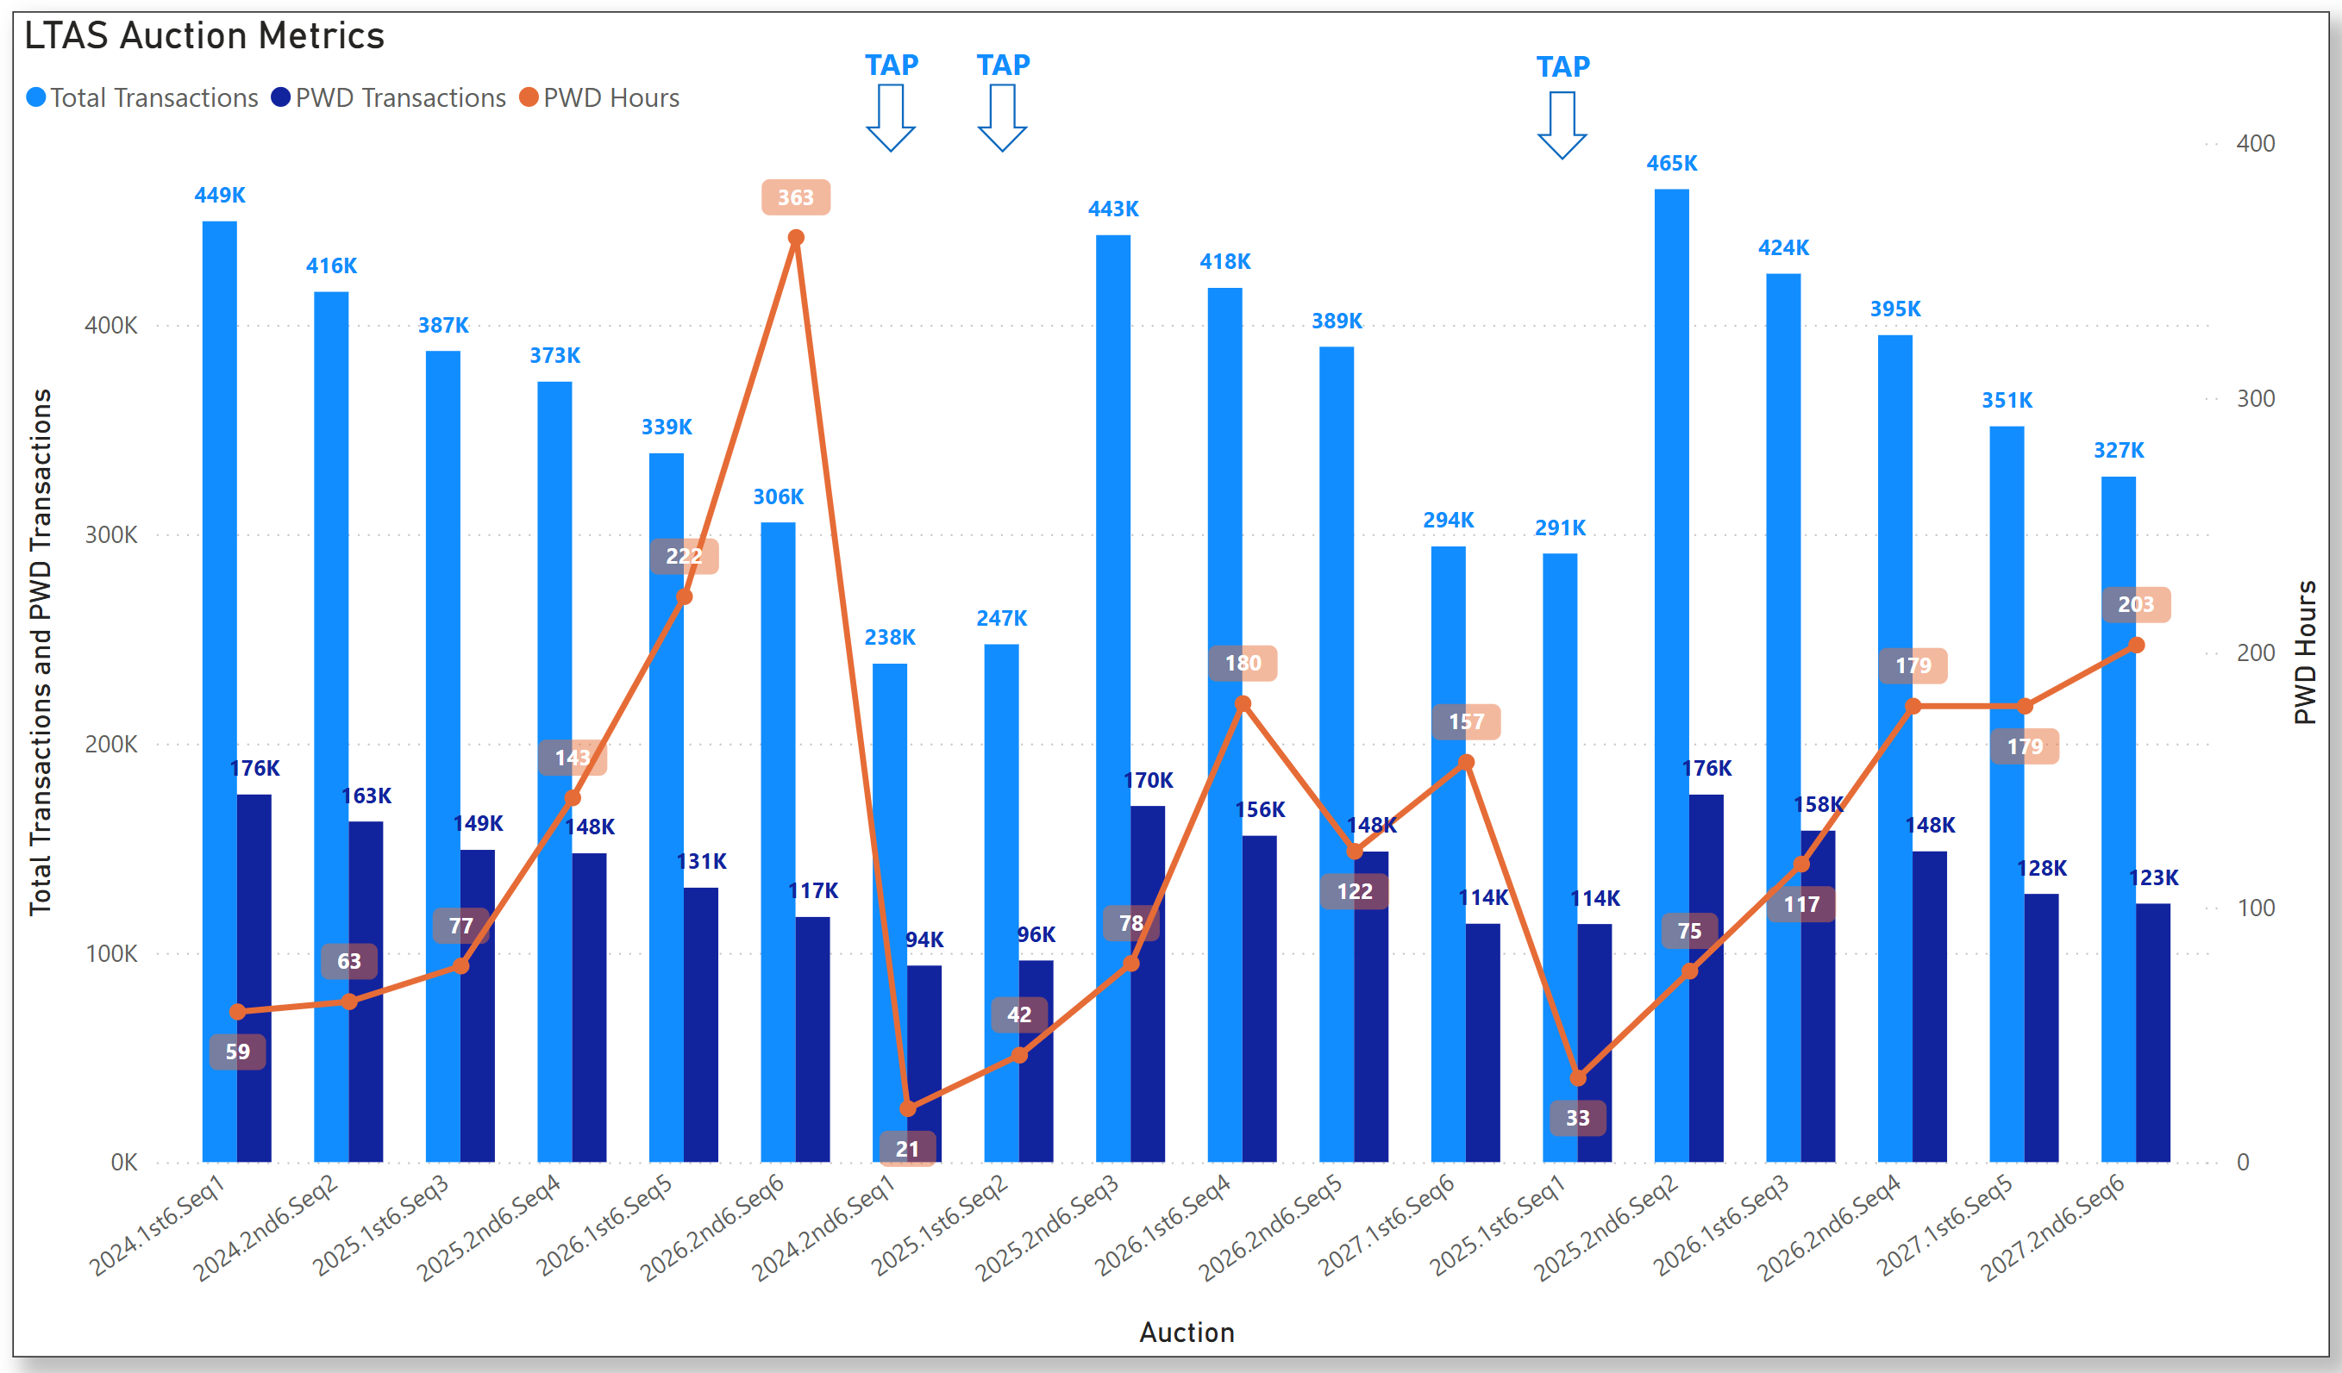
Historical LTAS transactions and solution times

Slide 4
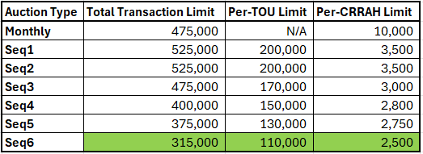
Update to CRR auction limits
NPRR1261 Operational Flexibility for CRR auction limits was approved by the PUCT on March 13.
https://www.ercot.com/mktrules/issues/NPRR1261
The 2025.2nd6.AnnualAuction.Seq1 will be the first LTAS to use the transaction limit table below.
Seq6 limits have been reduced by 10K/10K/200 due to the most recent Seq6 solution time and increasing participating CRRAHs.

