Slide 1
ERCOT Annual Inertia Analysis
04/16/2025
PDCWG
ERCOT Operations Planning

Slide 2
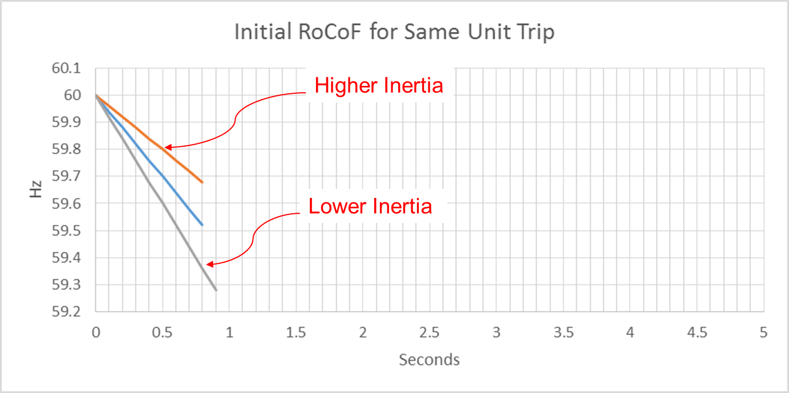
Effect of Synchronous Inertia on System Frequency
With the increasing integration of inverter-based resources (IBRs), fewer synchronous machines are online, potentially resulting in extended periods of lower overall system inertia
Higher system inertia → Lower RoCoF
Lower system inertia → Higher RoCoF
With the implementation of Fast Frequency Response (FFR) the static value of 100 GW*s for Critical Inertia is more dynamic now
UFLS trigger
RoCoF: Rate of Change of Frequency

Slide 3
Inertia Calculation and Monitoring
In 2013, as instantaneous wind power penetration reached 30%, ERCOT started analyzing impacts of IBR on system inertia
In 2015, ERCOT implemented a real-time inertia calculation using inertia parameters of each individual synchronous generator and its status (on/off) telemetry
$M_{sys}=\sum_{i∈I}{H_{i}∙{MVA}_{i}}\left[GW∗s\right]$
where I is the set of online synchronous generators or condensers, MVA_{i} is MVA base of on-line synchronous generator or synchronous condenser i, and H_{i} is inertia constant for on-line generator or synchronous condenser i in a system (in seconds on machine MVA_{i})
Monitor grid conditions closely when system inertia < 120 GW*s
Take Actions when system inertia < 105 GW*s
Target increasing system inertia >= 105 GW*s

Slide 4
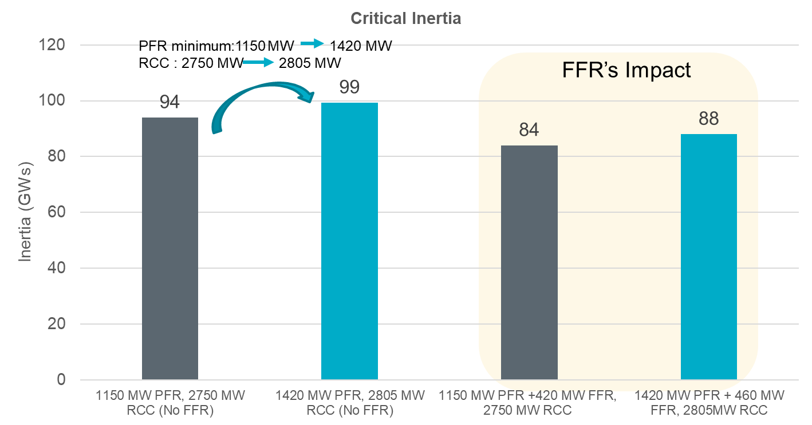
Fast Frequency Response (FFR) Added in 2020
What is FFR?
The automatic deployment and provision by a Resource of their obligated response within 15 cycles after frequency meets or drops below 59.85HZ. Resources must be capable of sustaining their obligated response for at least 15 minutes.
Studies indicate that FFR can help reduce the minimum level of Inertia at which ERCOT grid can operate reliably.

Slide 5
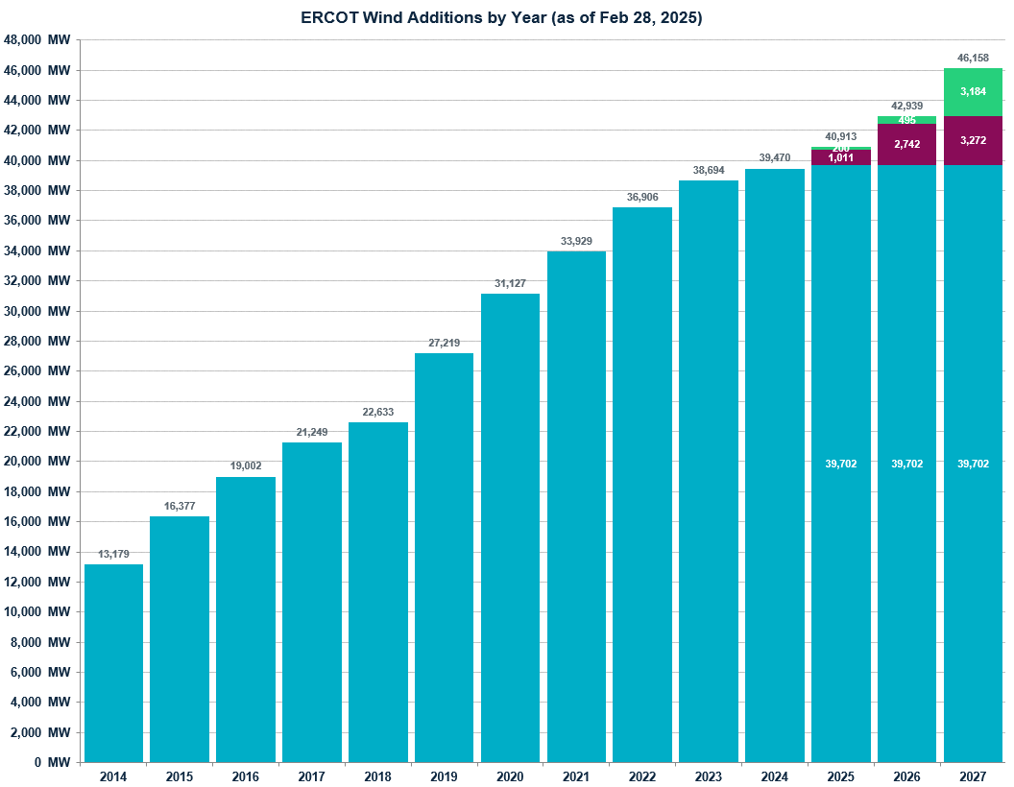
Wind Generation Capacity
+1,788 MW
+776 MW
+2,977 MW
+2,802 MW
+3,908 MW
+4,587 MW
+1,384 MW
+2,247 MW
+2,625 MW
+3,198 MW

Slide 6
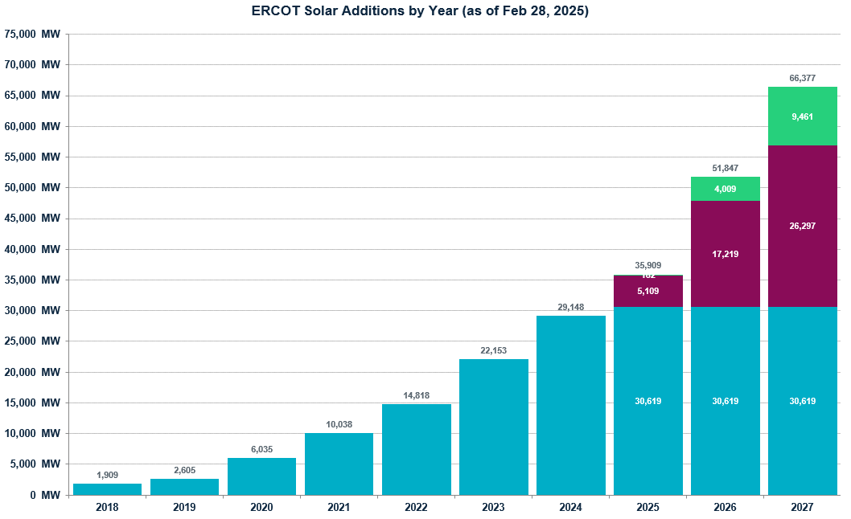
Solar Generation Capacity
+6,995 MW
+7,335 MW
+4,780 MW
+4,003 MW
+3,429 MW
+696 MW

Slide 7
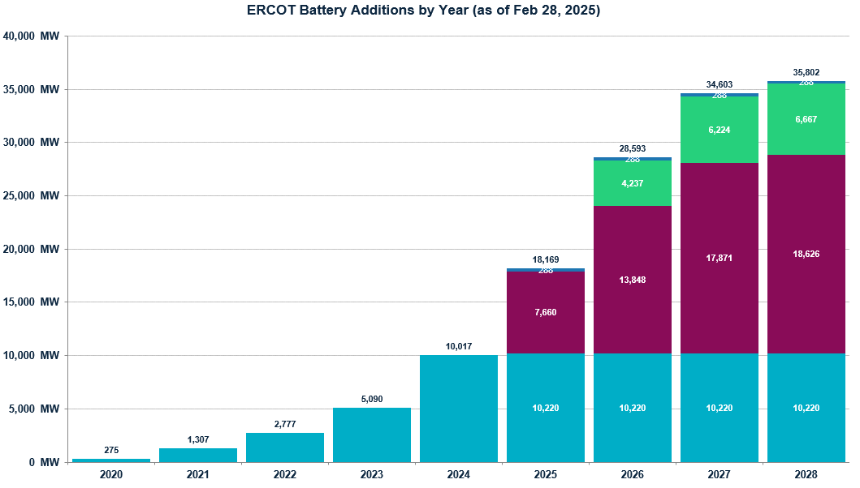
Battery Capacity
+4,927 MW
+2,313 MW
+1,470 MW
+1,032 MW

Slide 8
Inertia Analysis

Slide 9
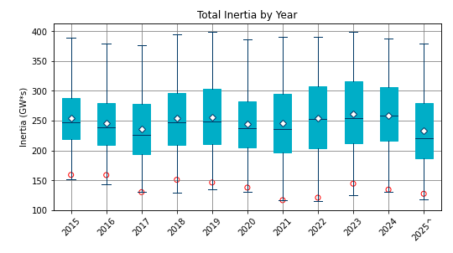
Total Inertia 2015-2025
Date and Time | 2015 11/25 2:00 AM | 2016 4/10 2:00 AM | 2017 10/27 4:00 AM | 2018 11/03 3:30 AM | 2019 3/27 1:00 AM | 2020 05/01 2:00 AM | 2021 03/22 1:00 AM | 2022 03/21 2:00 AM | 2023 04/18 3:00 AM | 2024 03/29 4:00 AM | 2025* 03/18 12:00 PM
Min synch. Inertia (GW*s) | 152 | 143 | 130 | 128.8 | 134.5 | 131.1 | 116.6 | 115.0 | 124.3 | 129.9 | 118.3
System load at minimum synch. Inertia (MW) | 27,190 | 27,831 | 28,425 | 28,397 | 29,883 | 30,679 | 31,767 | 33,784 | 35,578 | 37,039 | 49,130
Non-synch. Gen. in % of System Load | 42 | 47 | 54 | 53 | 50 | 57 | 66 | 65 | 61 | 68 | 74
FFR Responsibility | N/A | N/A | N/A | N/A | N/A | 0 | 0 | 0 | 0 | 134 | 298
Critical Inertia (GW*s) | 100 | 100 | 100 | 100 | 100 | 100 | 100 | 100 | 100 | 93 | 92
Red circles denote inertia at max IRR penetration (= IRR Gen/Total Gen)

Slide 10
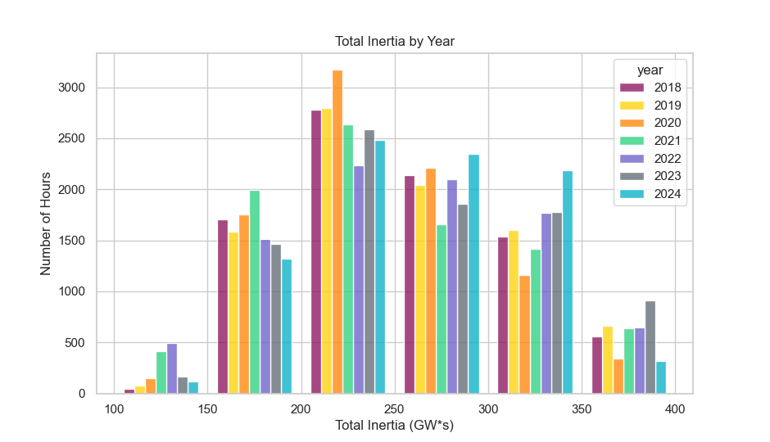
Total Inertia by Group 2018-2024
In 2024, less hours below 150 GW*s and more hours between 250 and 350 GW*s

Slide 11
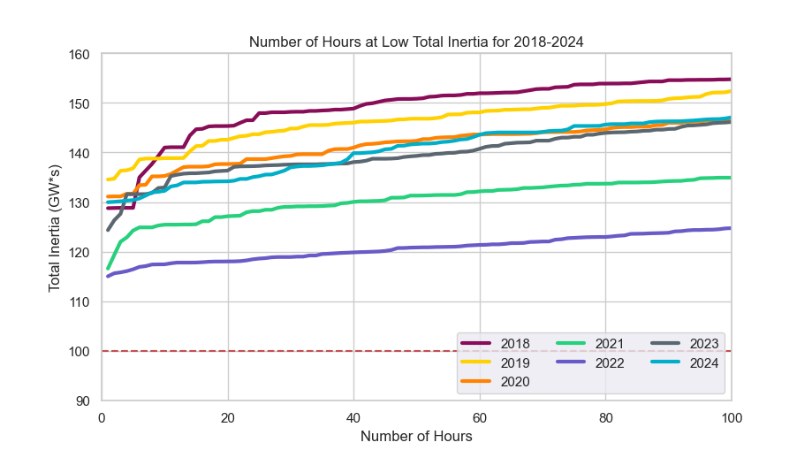
Lowest 100 Hours of Total Inertia 2018-2024
Similar trends to 2020 and 2023
 | 2018 | 2019 | 2020 | 2021 | 2022 | 2023 | 2024
Lowest Inertia Hour (GW*s) | 129 | 135 | 131 | 117 | 115 | 124 | 130
100th Lowest Inertia Hour (GW*s) | 155 | 152 | 147 | 135 | 125 | 146 | 147

Slide 12
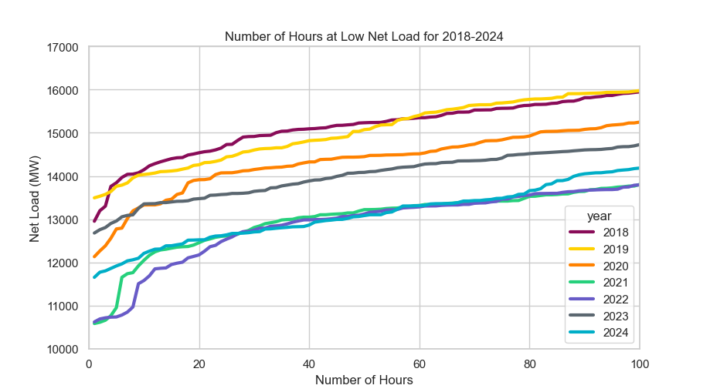
Lowest 100 Net Load Hours 2018-2024
Similar trends to 2022 and 2021 for the lowest 80 - 30 Net Load Hours

Slide 13
Observation 1

Slide 14
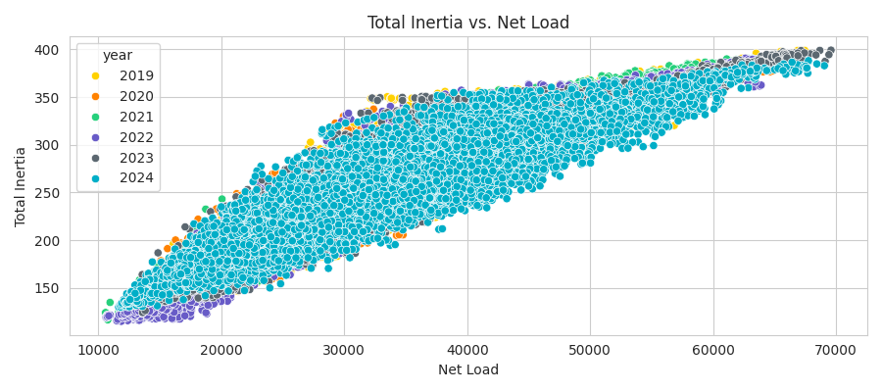
Correlation between Inertia and Net Load
Inertia and net load exhibit a strong correlation

Slide 15
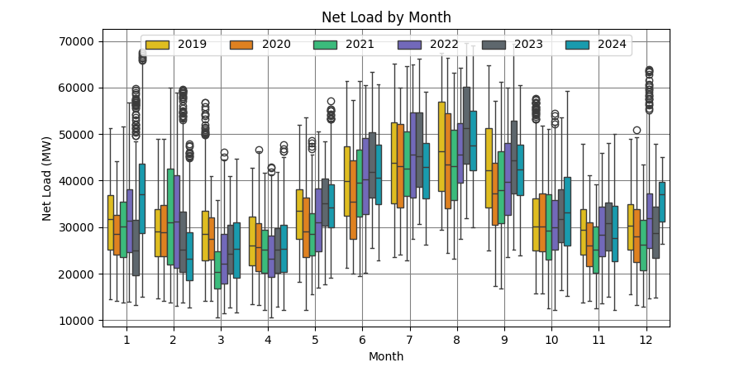
Net Load by Month 2019-2024
In 2024, the average net load decreased in the months of June – Sep and Feb, where net load was less than last year and increased or experienced minimal change in the months of Oct – Jan
Net Load = Load – Wind Generation – Solar Generation

Slide 16
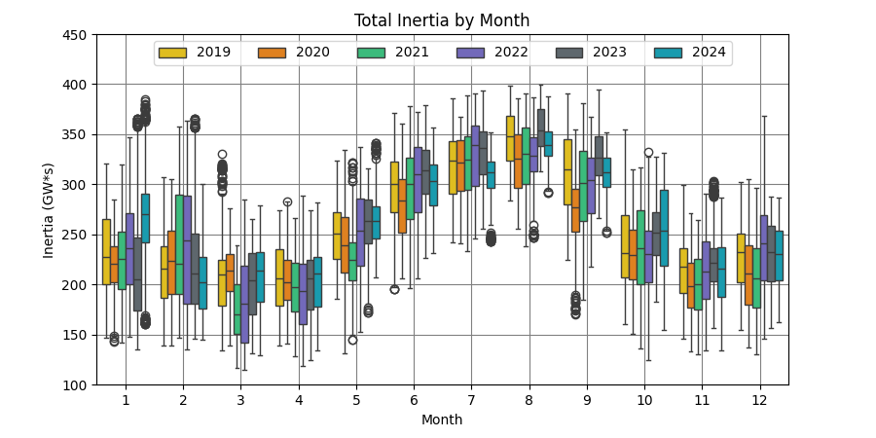
Total Inertia by Month 2019-2024

Slide 17
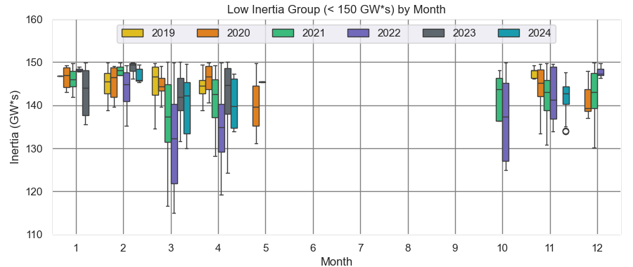
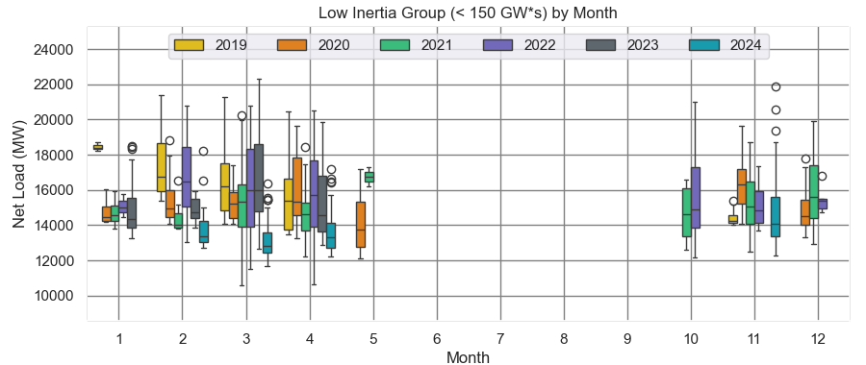
Low Inertia Group (< 150 GW*s) by Month 2019-2024
In the spring of 2024, inertia stayed roughly the same in the low inertia group, but net load decreased significantly

Slide 18
Observation 2

Slide 19
Average Net Load per Hour 2019-2024
In 2024, the average net load per hour shifted its lowest net load from the early morning to the middle of the day.
Likely due to the rapid increase in Solar Gen which saw an almost 10x growth in 2024

Slide 20
Average Inertia per Hour 2019-2024
In 2024, lowest hours of inertia have moved from the night hours to the middle of the day

Slide 21
Observation 3

Slide 22
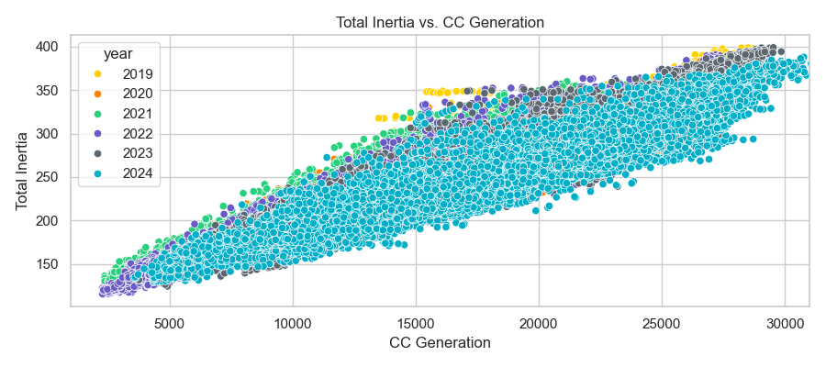
Correlation between CC Generation and Total Inertia
CC Generation and Total Inertia exhibit a strong correlation

Slide 23
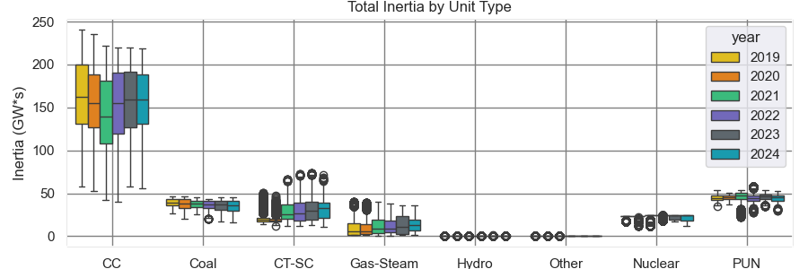
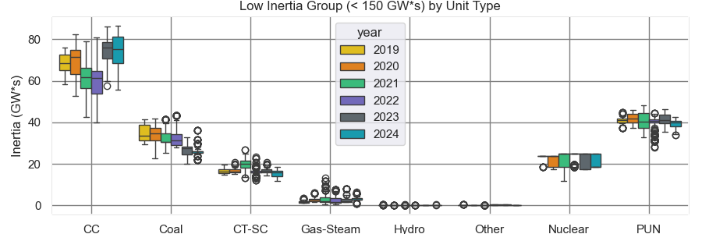
Total Inertia by Unit Type 2019-2024

Slide 24
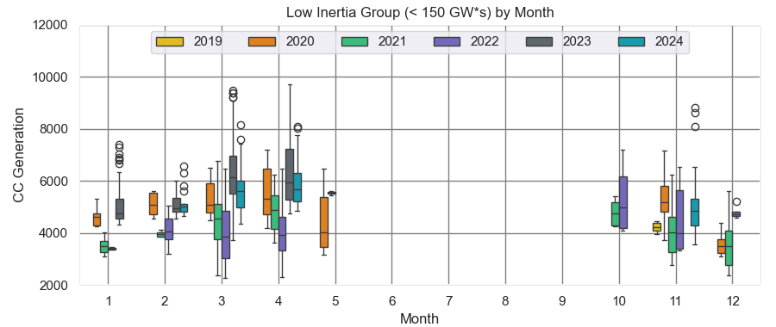
CC Generation in Low Inertia Period by Month 2019-2024
In the spring of 2024 (Mar-Apr), CC Generation decreased compared to Spring 2023 during the low inertia period

Slide 25
Summary
Lowest system inertia in 2024 was 129.9 GW*s
2024 experienced less hours below 150 GW*s and more hours between 250 and 350 GW*s
In 2024, the average inertia decreased in the months of June – Sep and Feb, where inertia was less than last year and increased or experienced minimal change in the months of Oct – Jan
In 2024, combined cycles experienced similar contributions during our lowest system-wide inertia hours as seen in the previous year but at a lower dispatch
Lastly, our lowest hours of inertia have moved from the night hours to the middle of the day
High growth in solar generation

Slide 26
Low Inertia by Month 2020-2025
This year as of April 1st, 2025, we have experienced 148 hours under 150 GW*s of Inertia. 140 of those hours happened in March.
2024: 120 2023: 165 2022: 492 2021: 417 2020:147
Our lowest inertia happened 3/18/2025 12:00 PM
118.3 GW*s.
298 FFR
92 GW*s – Critical Inertia

Slide 27
Thank you!
Questions

Slide 28
Appendix

Slide 29
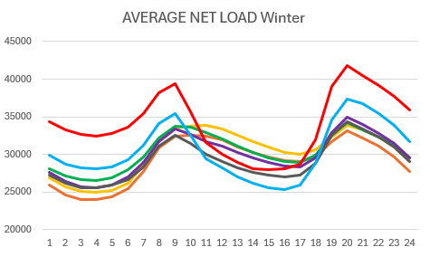
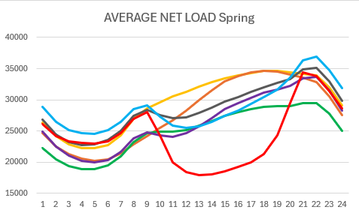
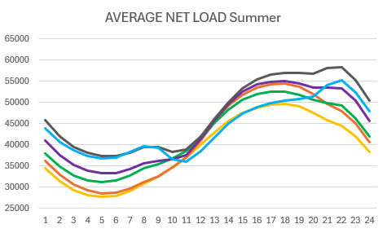
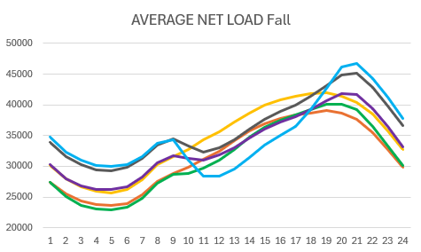
Average Net Load by Hour 2019-2025
Net Load
Hour

Slide 30
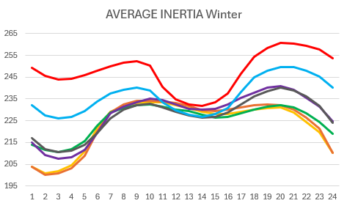
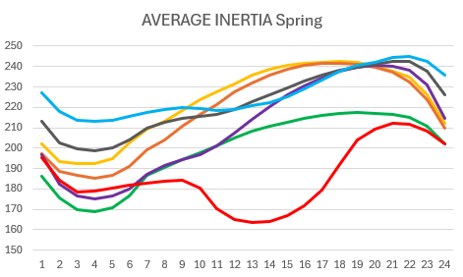
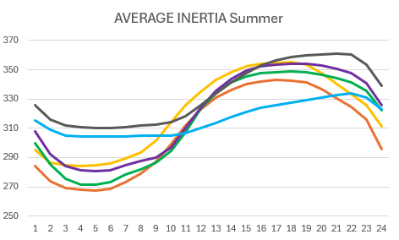
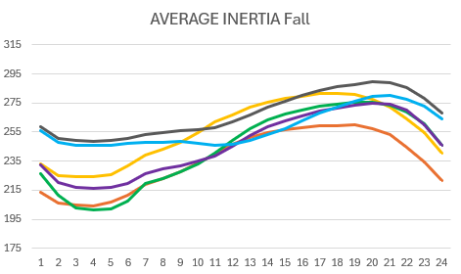
Average Inertia by Hour 2019-2025
Inertia (GW*s)
Hour

Slide 31
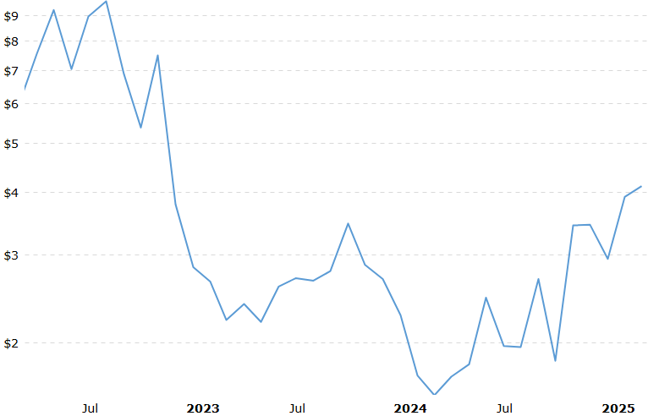
Gas Prices 2022 - 2025
March 2025
$4.11
March 2024
$1.57
Source: Macrotrends (Natural Gas Prices)

